Slide 1

Introduction to classes

Slide 2
Outline
In this lesson, we will:
  Describe issues with using only primitive data types
  Look at examples where simple local variables are insufficient
  Introduce the idea of classes to solve this problem

Slide 3
Limitations of primitive data types
To this point, we have discussed primitive data types:
char
short int long
float double
bool
  In reality, most complex objects require more parameters to describe them
Even now, every time we send an array as an argument,
we must also send the capacity as a separate parameter

Slide 4

Limitations of primitive data types
Suppose you create a triangle element for a tessellation
  Such a triangle has:
    Three corners
      Each corner has three coordinates
    A color
      A color has three values: red, green and blue
  This is just 12 variables

Slide 5
Limitations of primitive data types
Suppose we author functions to render or manipulate such triangles
  Each function could have up to twelve parameters
Suppose we now add a transparency
  We may have to update every function,
  and consequently, every updated function call

Slide 6
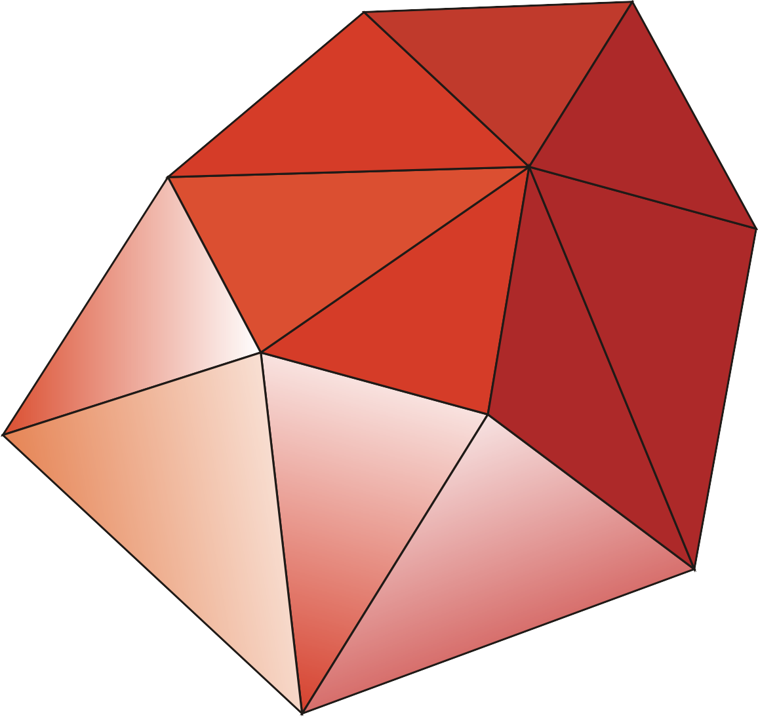
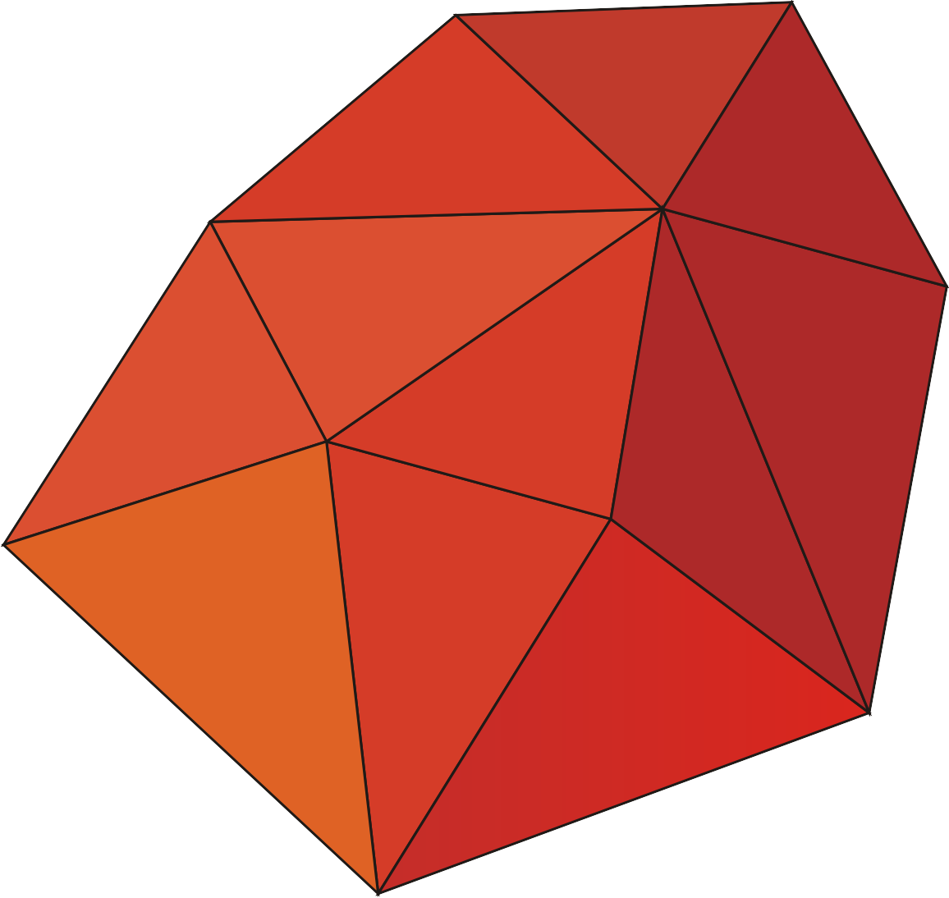
Limitations of primitive data types
Now, suppose we wanted to create a simple surface:
  Here we have eleven triangles
  This is 99 coordinates, 11 colors and 11 transparency levels
We could store this as a number of arrays
  However, we must still pass a number of arrays
Suppose after a while, you want to add a fountain fill
  Each triangle now requires direction and a second color
  Now we must update every function
  and every function call again…

Slide 7

Limitations of primitive data types
Such tessellations are the basis of most rendered images
  This one was created by Gilles Tran (see http://www.oyonale.com/)

Slide 8
Limitations of primitive data types
Also, notice that color is something independent of a triangle
  Does every object that has a color need to deal with colors independently?

Slide 9
Student records
Suppose you want to create a marks manager
  Every student has:
    A given name or names std::string Syed
    A surname std::string Inzamam-ul-Haq
    A uWaterloo student id number std::string 20071005
    A uWaterloo user id std::string inzi
    A program std::string COMPE
    A list of zero or more courses, each of which has:
      A subject id std::string ECE
      A subject number std::string 150
      A term in which it was taken std::string 0979
      A grade int 71

Slide 10
Student records
All this data could be stored in arrays and arrays of arrays…
  We could author a number of functions to calculate:
    Term averages
    Overall averages
  Much of this data would have to be passed to these functions
Once again, suppose we want to add grading designations
  Only some courses count towards the term and cumulative averages
  Once again, we’d have to modify all functions that require this information, and all function calls to these functions
Engineers cannot have more than three failed courses
  While updating grading designations,
  one may forget to update such code, as three failed courses only count those that count towards averages

Slide 11
Student records
Additionally, suppose someone makes a mistake:
  They use these arrays but accidentally assign a grade of 110
  What if the course was listed as ece 155, instead?
There is no way to check this,
as any user can modify any entry in any of the arrays
Suppose that a user accidentally modifies the capacity of an array:
if ( courses_taken[n] = 0 ) {
// The 'n'th student has not taken any
// courses yet
} else {
// Calculate the overall average
}

Slide 12
Classes to the rescue
Classes are a means of aggregating and also protecting data
  Definition: aggregate (noun)
    A whole formed by combining several (typically disparate) elements.
  Any such type is a collection of member variables,
  each of which is either a primitive data type, or even other classes
    Unlike arrays, different member variables can have different types
  Any local variable of that type allows each member variable to have
  different values
  Like variables of type int and double that can be modified and passed to functions,
  instances of classes can have their member variables modified and yet they can be passed as a whole to functions

Slide 13
Summary
Following this lesson, you now
  Understand the issues with primitive data types
  Understand the need for user-defined aggregate data types
  Have an idea as to what we will be covering in this section

Slide 14
References
[1] No references?

Slide 15



Colophon
These slides were prepared using the Georgia typeface. Mathematical equations use Times New Roman, and source code is presented using Consolas.
The photographs of lilacs in bloom appearing on the title slide and accenting the top of each other slide were taken at the Royal Botanical Gardens on May 27, 2018 by Douglas Wilhelm Harder. Please see
https://www.rbg.ca/
for more information.

Slide 16
Disclaimer
These slides are provided for the ece 150 Fundamentals of Programming course taught at the University of Waterloo. The material in it reflects the authors’ best judgment in light of the information available to them at the time of preparation. Any reliance on these course slides by any party for any other purpose are the responsibility of such parties. The authors accept no responsibility for damages, if any, suffered by any party as a result of decisions made or actions based on these course slides for any other purpose than that for which it was intended.

